Slide 1
Content Based Image Retrieval
M Osama Nusrat(21i-2169)
Zeeshan Habib(21i-2193)
Abdul Basit Abbasi
MS-AI
20/05/2023
Project
1

Slide 2
Introduction
Content-Based Image Retrieval (CBIR) is a method used to search and retrieve images from large-scale image databases based on the actual visual content of the image rather than relying on manually tagged metadata or keywords.
Unlike traditional methods which rely on human-added tags or annotations, CBIR automatically analyzes and compares visual information.
20/05/2023
Project
2

Slide 3
WHY CBIR
Manually tagging and annotating images isn't practical or efficient anymore.
With CBIR, you can automate the image retrieval process, increasing speed, efficiency, and the relevancy of the results.
CBIR can find patterns and similarities that humans might miss.
20/05/2023
Project
3

Slide 4
Applications
CBIR has a wide range of practical applications.
Medical imaging
We can utilize CBIR to find similar medical images that can aid in diagnosis.
Surveillance systems
In surveillance systems, CBIR can help identify individuals or objects of interest.
20/05/2023
Project
4

Slide 5
Applications
Digital libraries
We can use it to categorize and retrieve images
E-commerce platforms
We can use CBIR for product recommendations based on visual similarity.
20/05/2023
Project
5

Slide 6
How Does CBIR Work?
CBIR operates by using computer vision algorithms to extract features from images in the database.
These features could be colors, textures, shapes, or any other visual element that can be quantified.
Each image is represented as a 'feature vector', essentially a list of its key features.
When a user submits a query image, CBIR extracts its feature vector and compares it with those in the database to find similar images
20/05/2023
Project
6

Slide 7
Motivation
Content-Based Image Retrieval (CBIR) is driven by several key motivations:
Growing Image Data: With the explosion of digital images generated every day, organizing and searching through them has become a daunting task. Traditional methods of tagging or manually annotating images can't keep up with this enormous volume of data. CBIR offers a more scalable and efficient solution.
Automated Analysis: CBIR systems are capable of automatically analyzing and categorizing images based on their content, which can improve efficiency and accuracy in many fields such as surveillance, medical imaging, e-commerce, digital libraries, and more.
Improved Search Accuracy: Traditional image retrieval systems rely on metadata and text annotations, which can be inconsistent and subjective. In contrast, CBIR uses objective visual content of the image, leading to more relevant search results.
20/05/2023
Project
7

Slide 8
Limitations of text-based approach
Problem of image annotation
Large volumes of databases
Valid only for one language — with image retrieval this limitation should not exist
Problem of human perception
Too much responsibility on the end-user
Queries that cannot be described at all, but tap into the visual features of images.
20/05/2023
Project
8

Slide 9
CBIR A sample search query
User wants to search for, say, many rose images.
user submits an existing rose picture as query.
user submits his own sketch of rose as query.
The system will extract image features for this query.
It will compare these features with that of other images in a database.
Relevant results will be displayed to the user.
20/05/2023
Project
9

Slide 10
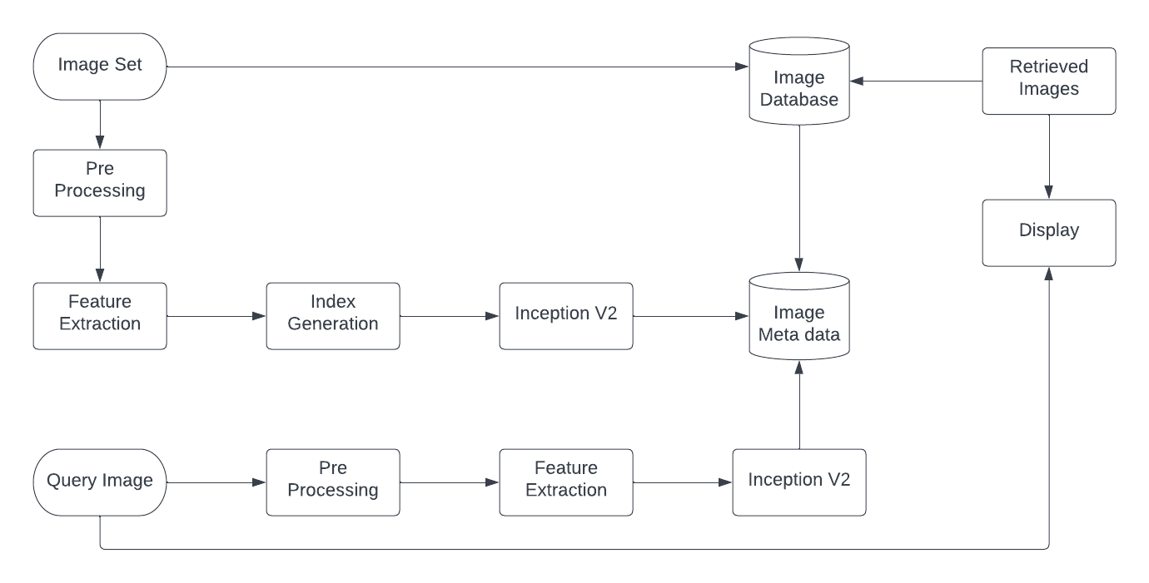
Proposed Approach.
Flow Diagram:
20/05/2023
Project
10

Slide 11
DATASET USED
The COREL Database for Content based Image Retrieval
There are total 10,800 images divided into 80 classes, e.g., autumn, aviation, bonsai, castle, cloud, dog, elephant, iceberg, primates, ship, stalactite, steam-engine, tiger, train, and waterfall etc.
https://sites.google.com/site/dctresearch/Home/content-based-image-retrieval
20/05/2023
Project
11

Slide 12
Feature Extraction
What are image features?
Primitive features
Mean color (RGB) General features
Color Histogram
Semantic features
Color Layout, texture etc...
Domain specific features
Face recognition, fingerprint matching etc...
20/05/2023
Project
12

Slide 13



Feature Extraction
Query Image
Retrieved Image
User
Image Database
Distance Measure
Features Space
Images
Features Set
20/05/2023
Project
13

Slide 14
System Flow.
Inception V2 creates a feature vector for each image extracted from the search database.
The feature vectors are made using the convolution layers of Inception V2.
The output tensor after passing through Conv Layers is the average pooled and normalized resulting in a feature vector.
When a query image is entered to get the similar outputs, at first step it is converted into a feature vector by passing it through the convolution layers of Inception V2.
20/05/2023
Project
14

Slide 15
System Flow.
At the next step the generated vector is then compared to all of the other feature vectors of images in the same category.
This process is done using cosine similarity.
The output will be a sorted array of the most nearly matching images.
20/05/2023
Project
15

Slide 16
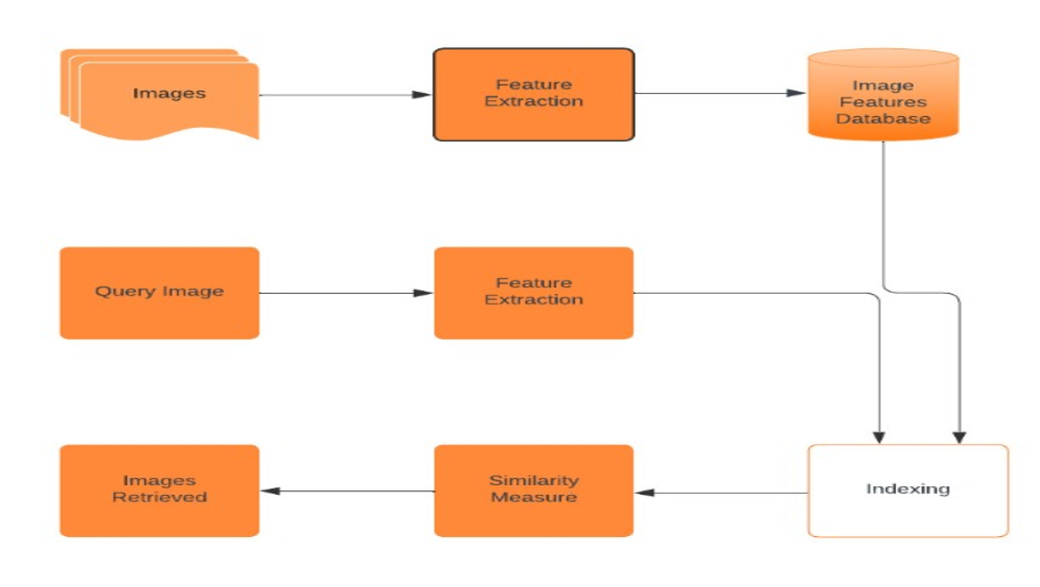
System Flow.
20/05/2023
Project
16

Slide 17
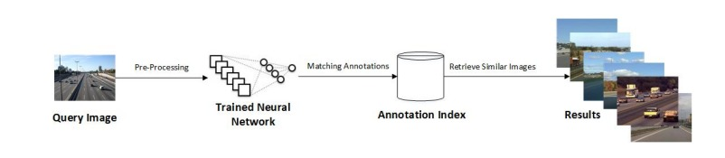
System Flow.
20/05/2023
Project
17

Slide 18
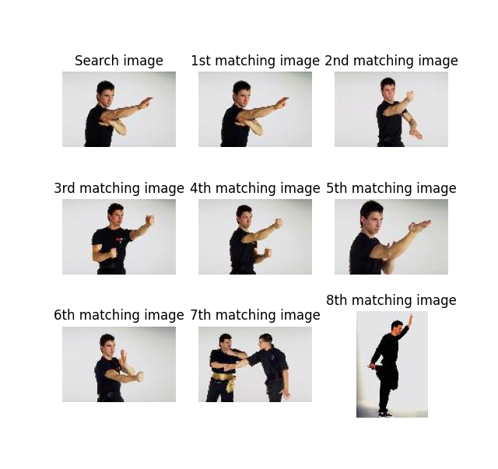
RESULTS

Slide 19
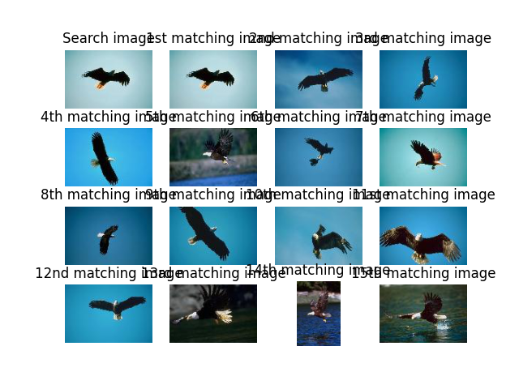
RESULTS

Slide 20
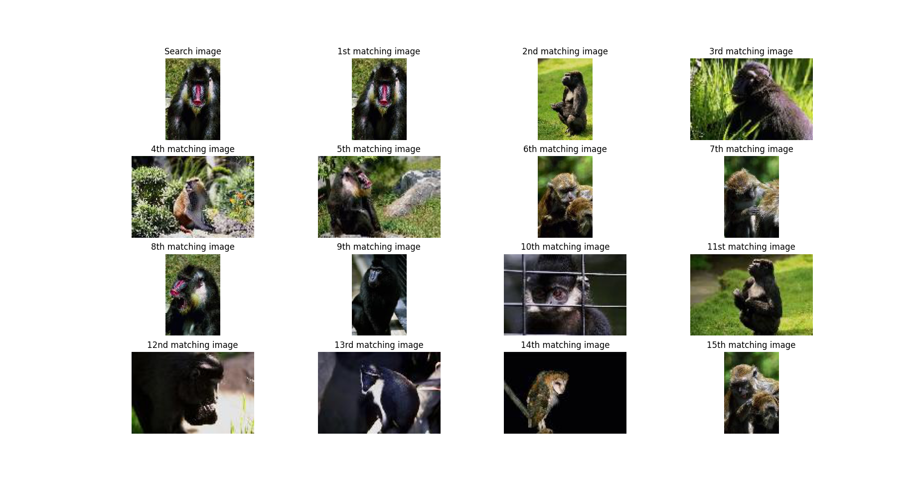
RESULTS

Slide 21
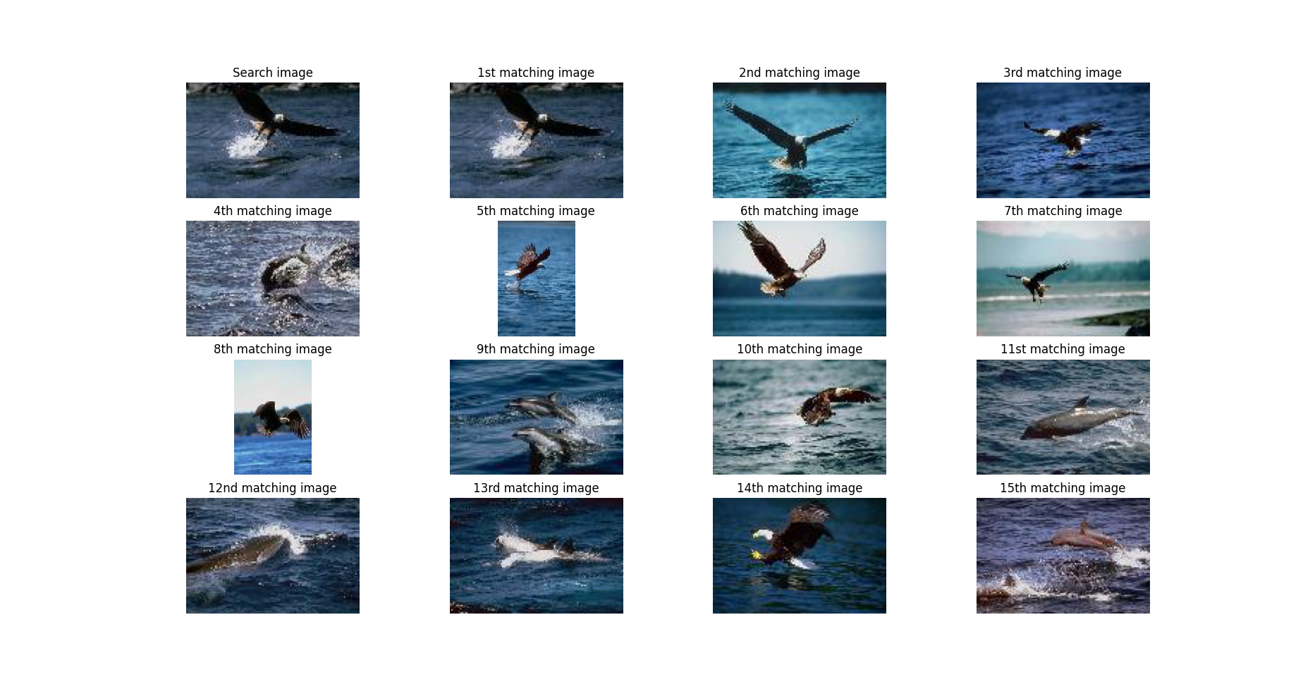
RESULTS

Slide 22
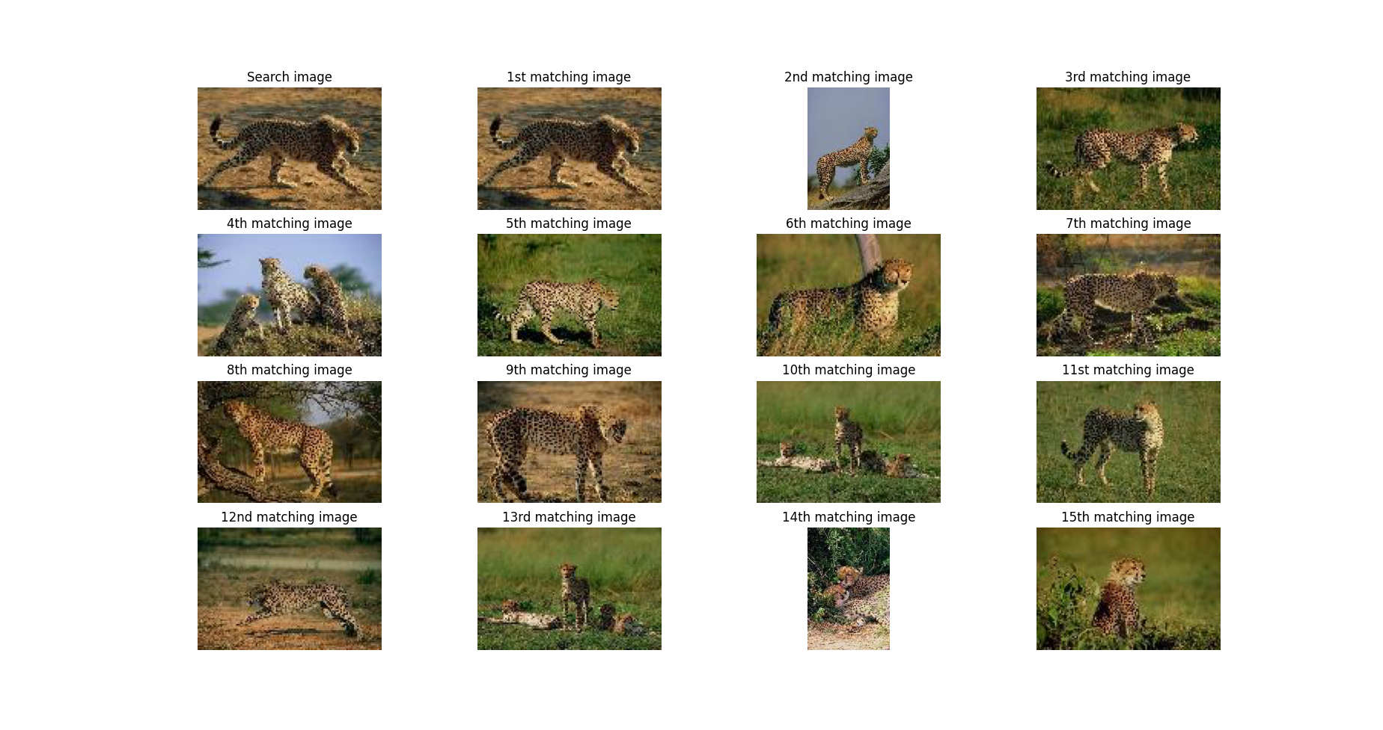
RESULTS

Slide 23
System Limitation.
Semantic Gap: The difference between human visual perception and an algorithm's computational interpretation of an image. For example, humans can easily recognise objects in various shapes, sizes, or colours, but an algorithm might struggle with such variations.
Consider an image of a cat sitting on a table in a kitchen. As a human, you can immediately recognise the cat, the table, and the kitchen environment. You can understand that the cat is a pet, the table is a piece of furniture, and the setting is a typical domestic space. However, a computer algorithm analysing the image may only identify the presence of shapes, colours, and textures.
20/05/2023
Project
23

Slide 24
CONCLUSION.
Each of the CBIR methods has their own advantages and disadvantages.
However, there is a need for a further work that will validate the reliability and efficiency of each of the method.
In our proposed system we achieved 82% precision.
Recall is achieved 85% by the proposed approach which is quite good.
20/05/2023
Project
24

Slide 25

20/05/2023
Project
25

